Slide 1
Scale-recurrent Network for Deep Image Deblurring
Student name: Tom Lev-ron.
Introduction to digital image processing.
Date: 14.01.2020.
Paper authors: Xin Tao, Hongyun Gao, Xiaoyong Shen, Jue Wang, Jiaya Jia.
The Chinese University of Hong Kong , YouTu Lab, Tencent 3Megvii Inc.

Slide 2
This Presentation will fucus more on the article and less on the subject

Slide 3
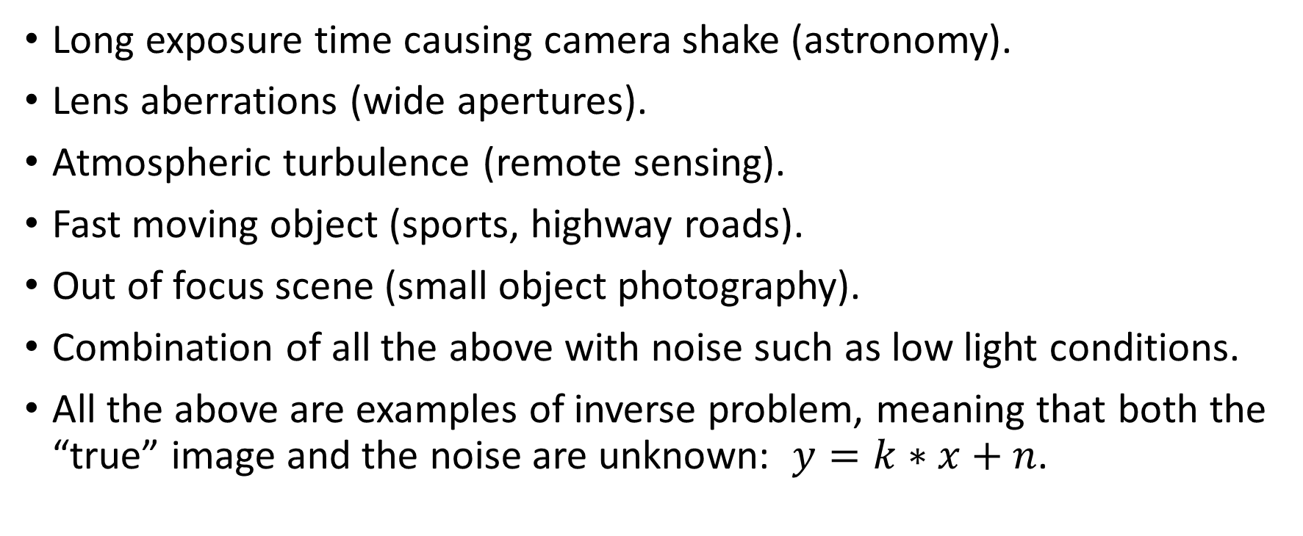
The Challenge – Single Image Deblurring
Long exposure time causing camera shake (astronomy).
Lens aberrations (wide apertures).
Atmospheric turbulence (remote sensing).
Fast moving object (sports, highway roads).
Out of focus scene (small object photography).
Combination of all the above with noise such as low light conditions.
All the above are examples of inverse problem, meaning that both the “true” image and the noise are unknown: $y=k∗x+n$.

Slide 4
Methods of Deblurring
Filtering (Inverse, Wiener, etc.).
Blind deconvolution with NN as blur estimator (restricted by different types of blur).
NN to inversely filter blurry images (learned inverse filter to deblur text).
learning-based approaches for blind deconvolution try to learn the deconvolution solution for a single image.
neural network to learn a general procedure that is directly applicable to diffrent images and blurs.

Slide 5
The Proposed Method
Scale-recurrent
What is multi-scale CNN?
What is Scale-recurrent CNN?

